Slide 1
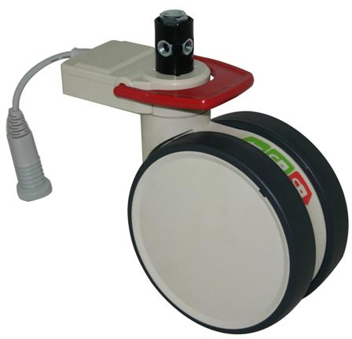
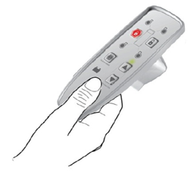


Hospital Beds
The next wave of innovation

Slide 2
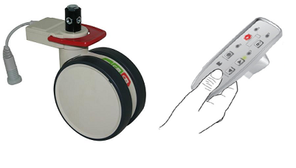
Hospital Beds
The next wave of innovation
Contents:
Inpatient falls – key data
Best practice & guidelines
Limitations of traditional central locking castors
Enter Trinity castors – the next wave
User interface – handset design
Technical information
Pricing
Development timeline
Key Selling Features

Slide 3

Inpatient falls – key data
It has been estimated that one third of people aged over 65 years suffer at least one fall per year. In Australian hospitals, 38% of all reported patient incidents involve a fall*
The most common location of patient falls was at the bed side (up to 43% of all falls occurred
from, or near, the patient’s bed).**
The most common activity associated with patient falls was transferring to or from a bed or chair.**
* Clarke R, Runciman W. Australian Incident Monitoring Study: Adelaide: Australian Patient Safety Foundation, 1998.
** Falls in Acute Hospitals - A Systematic Review. David Evans, Brent Hodgkinson, Leonnie Lambert, Jacky Wood and Inge Kowanko 1998

Slide 4
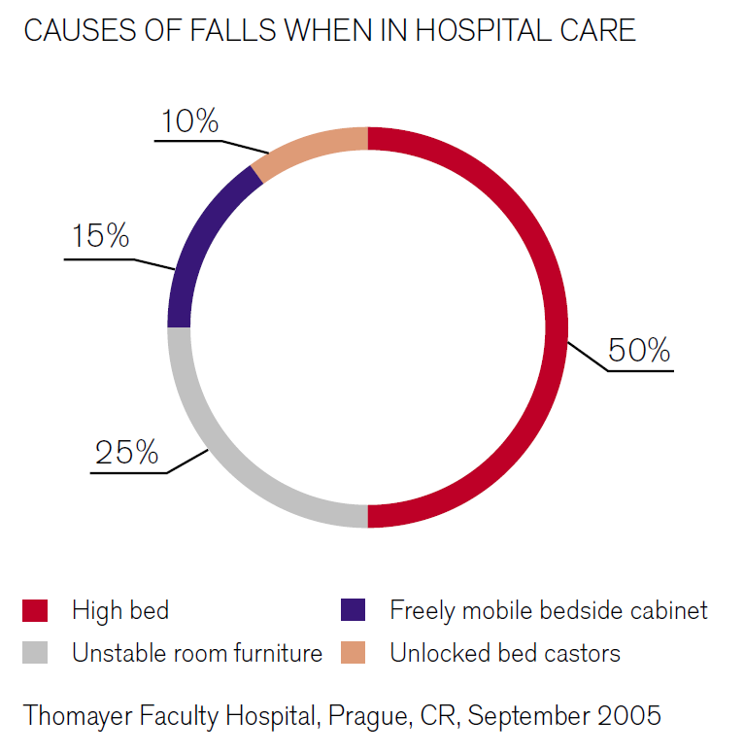
Inpatient falls – key data
Source: www.linet.com

Slide 5

Inpatient falls – key data
Fall Rate: Falls per 1000 Bed Days*
• Acute Care: 2.2 – 7.0 falls
• Rehabilitation: 8.9 – 19.8 falls
• Long Term Acute Care: 11.9 – 24.9 falls
Injury Rates:*
• 29 – 48% of falls result in injury
• 4 – 7.5% of fall-related injuries are serious
Cost of falls:**
Impact of an average fall in the USA was $11,042 to the hospital while home nursing costs were $5,325 leading to a total cost of $19,440 (1996 prices).
* Morse, J. (2002). Enhancing the safety of hospitalization by reducing patient falls. AJIC, 30 (6), 376-380.
** Rizzo JA, Friedkin R, Williams CS Nabors J, Acampora D Tinetti ME. Health care utilization and cost in a Medicare population by fall status. Medical Care 36(8):1174-88, 1998 Aug.

Slide 6
Best practice & guidelines
Fall prevention strategies and published best-practice guidelines uniformly recommend addressing both:
Intrinsic fall risk factors (to do with, for example, the patient’s condition, such as age, diseases, mobility and medications); and
Extrinsic fall risk factors (environmental hazards to do with the physical environment, equipment, clothing & footwear etc.)
Key recommendations from leading health organisations relating to extrinsic risk factors and specifically to hospital bed design are:
Australian Commission on Safety and Quality in Health Care:
Make the environment safe by ensuring that the bed is at the appropriate height for the
patient (in most cases, it should be at a height that allows the patient’s feet to be flat
on the floor, with their hips, knees and ankles at 90-degree angles when sitting on the bed), and the wheels or brakes are locked when the bed is not being moved.
(Preventing Falls and Harm From Falls in Older People: Best Practice Guidelines for Australian Hospitals 2009)

Slide 7
Best practice & guidelines
Key recommendations from leading health organisations relating to extrinsic risk factors and specifically to hospital bed design are:
US Food & Drug Administration (FDA):
Keep the bed in the lowest position with wheels locked.
(A Guide to Bed Safety – Bed Rails In Hospitals, Nursing Homes & Home Health Care: The Facts October 2000 (Revised 4/2010)
The Victorian Government Department of Human Services (Metropolitan Health & Aged Care Services Division)
Individual environmental risk factor: bed brakes not on or broken.
What contributes to the risk? Bed brakes are often unlocked, and the bed moved during domestic activities.
Actions: Ensure bed brakes are on/locked after the bed is moved. Ensure that regular monitoring and maintenance is undertaken on the beds.
(Minimising the Risk of Falls & Fall-related Injuries – Guidelines for Acute, Sub-acute and Residential Care Settings 2004)

Slide 8

Best practice & guidelines
But is it really realistic to expect nurses and orderlies to always apply the brakes...?
What if the brakes could be applied automatically...?
And if you were totally redesigning central locking castors, what other issues would you address at the same time...?
What are the existing limitations of traditional central locking castors?

Slide 9
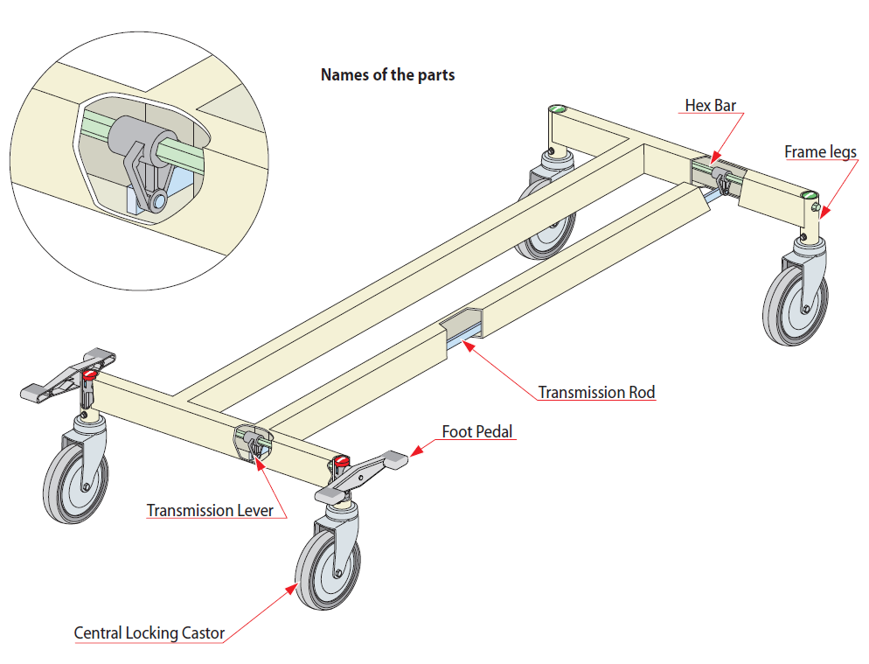
Limitations of traditional central locking castors
The castors are activated by a hex rod system (approx US$50 cost, difficult to install, can warp)
 Electronic castors remove this limitation
The control system (pedal) is manual, hard to push (approx 12kg) and not part of the main of the handset and able to be reviewed at easy eye level.
Central locking castors are also not intuitive – castors with 3 brake positions controlled by pedals with no labelling are confusing...
 Electronic castors remove this limitation

Slide 10
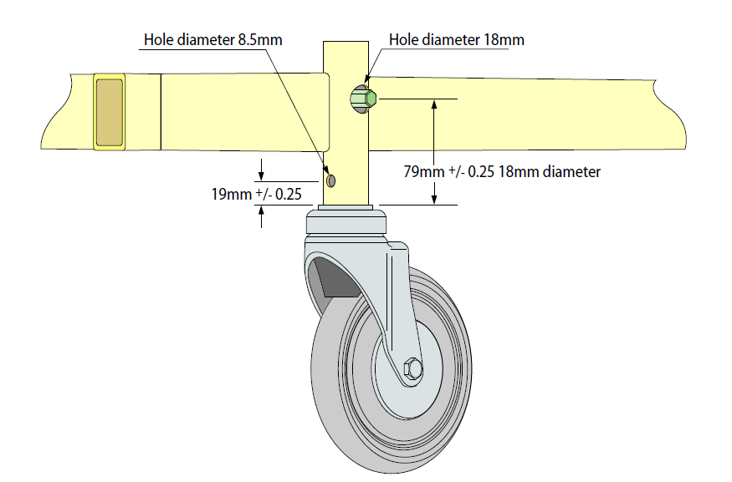
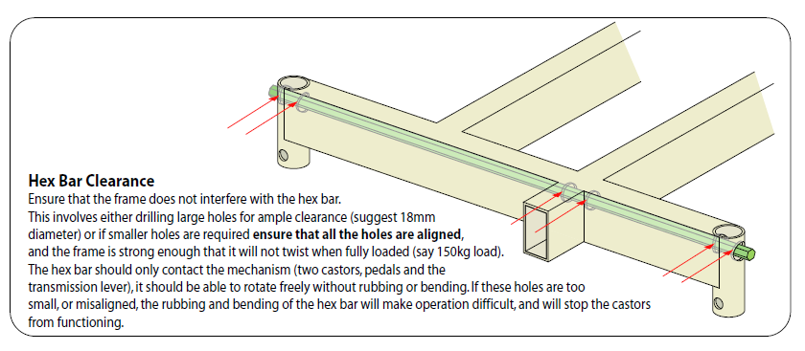
Limitations of traditional central locking castors
The castors rotate the hex rod with a CAM that has only 3mm of movement between the 3 brake positions. This makes hole sizes and positions along the whole length of the bed frame as well as the castor tolerances very, very tight and difficult to control. This adds cost and complexity to the bed frame manufacturing process.
 Electronic castors remove this limitation

Slide 11
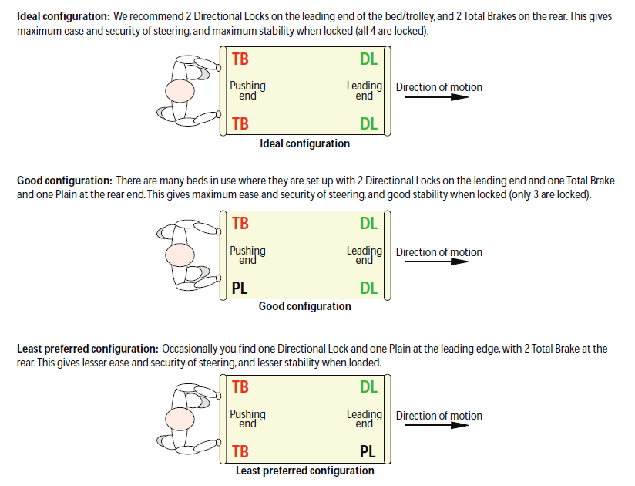
Limitations of traditional central locking castors
The orientation of the DL castors is fixed...
 Electronic castors remove this limitation
Hard to push from the non-DL end.
 Electronic castors remove this limitation

Slide 12

Limitations of traditional central locking castors
Traditional hex-rod style bed frames increase the height of beds and preclude the column-style floor bed design - and column style hi-low floor beds are a rapidly growing market that is a major piece of the fall-reduction puzzle.
The long pintle height to facilitate hex rod above the castor also adds height to the castor.
Removing the hex rod bed frame design limitations opens up many new doors of design freedom and allows better under-bed access to other equipment.
 Electronic castors remove this limitation
And the big one...
The brakes have to be manually applied... enter human error...
 Electronic castors remove this limitation

Slide 13
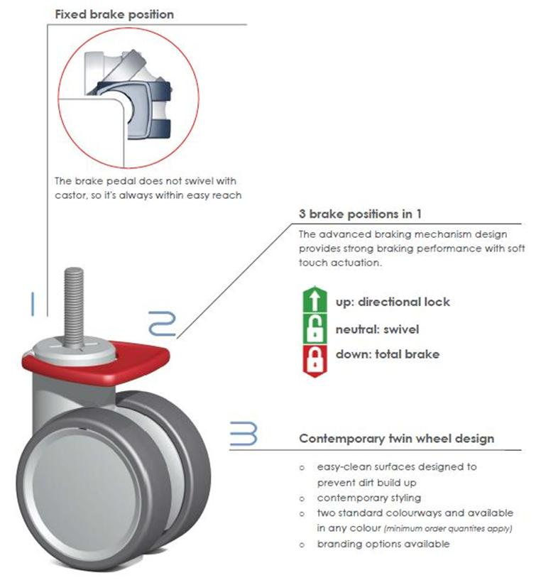

Enter Trinity castors – the next wave

Slide 14
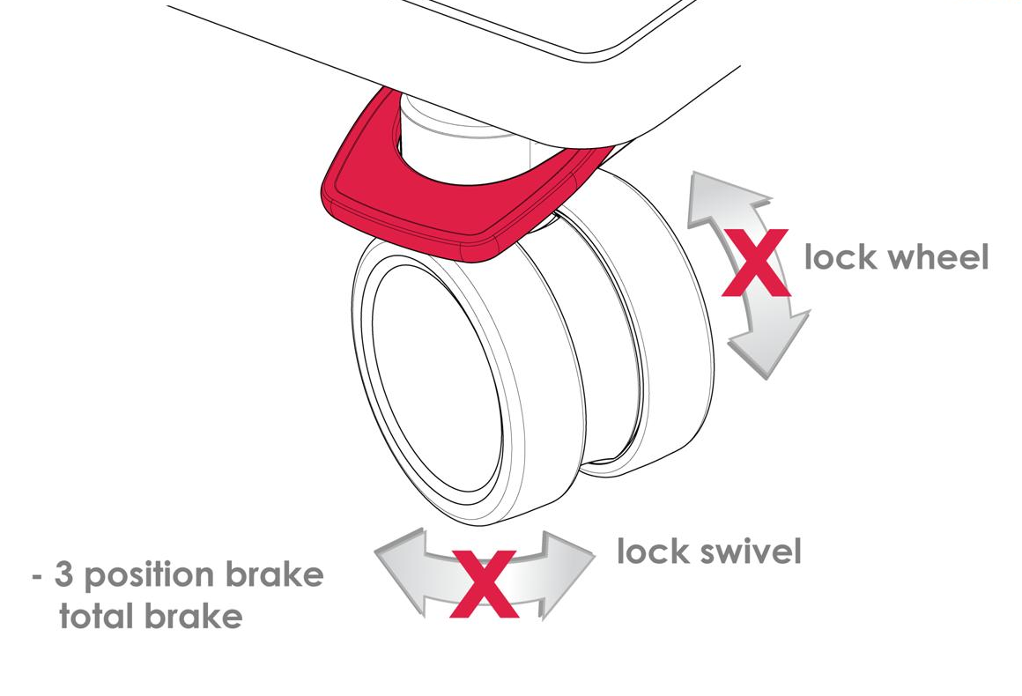
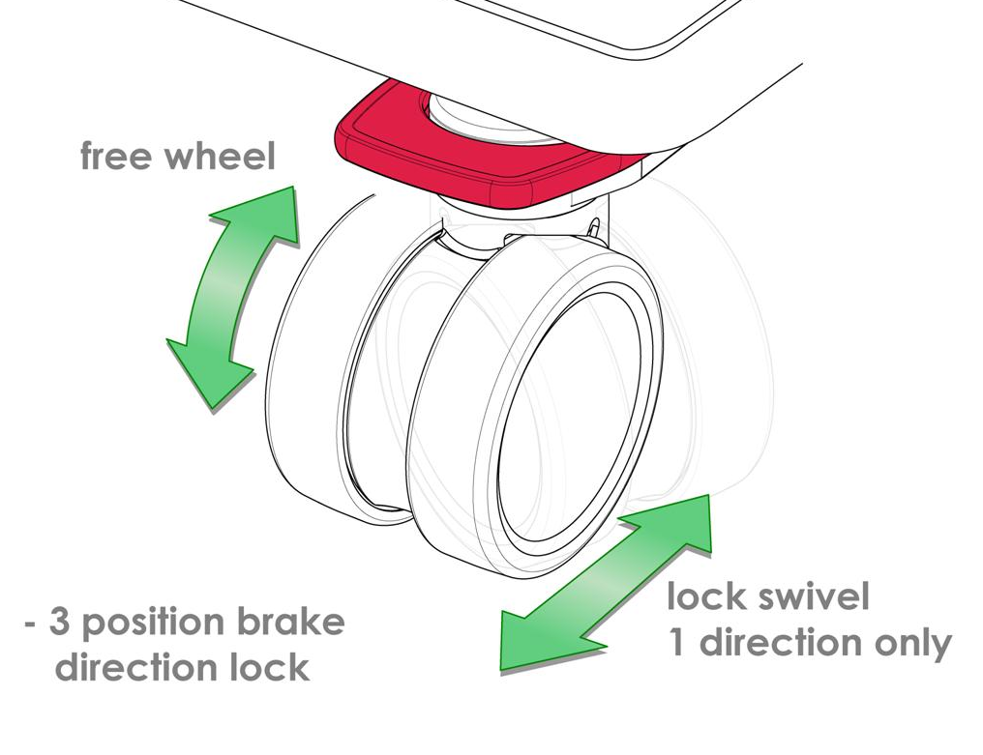
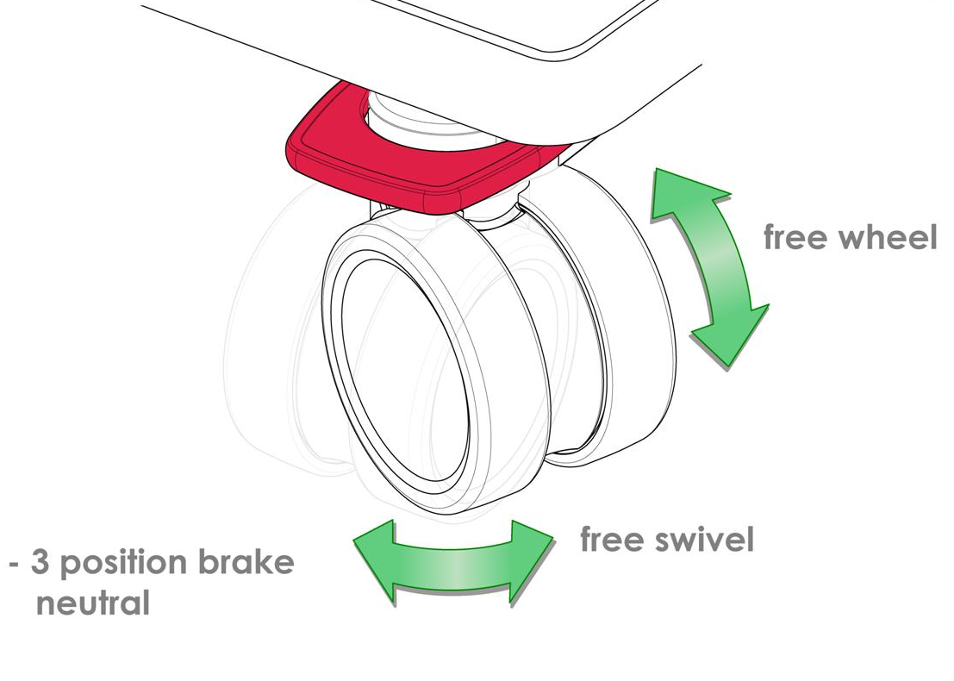
3 brake positions:
Neutral
Total brake
Directional Lock
with fixed pedal (pedal always in same position)

Slide 15

User interface: handset or pedals?
Whatever YOU want!
Want neutral?
Move the pedal on any 1 of the 4 castors to neutral, and the rest will follow.
Want total brake?
Move the pedal on any 1 of the 4 castors to brake, and the rest will follow.
Want directional lock from bed head?
Move the pedal on any 1 of the 2 castors at the head end to steer, and the other castor at the same end will also move to steer with the 2 castors at the opposing end moving to neutral.
Want directional lock from bed foot?
Move the pedal on any 1 of the 2 castors at the foot end to steer, and the other castor at the same end will also move to steer with the 2 castors at the opposing end moving to neutral.
Good design should be intuitive.
Some people prefer buttons: use them ☺
Some people prefer pedals: use them ☺
No instruction manual required!

Slide 16
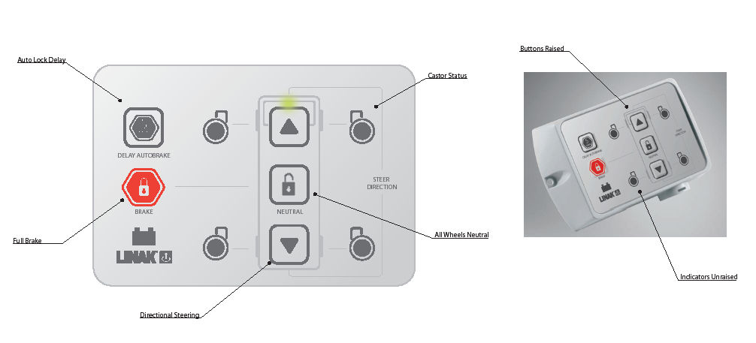
User interface – handset design
Handset Design
  Controls brake position:
  Neutral / Brake / Steer from head / Steer from foot
  Brake automatically applied after 60 seconds of non-movement
  Auto brake can be delayed for 5 minutes

Slide 17
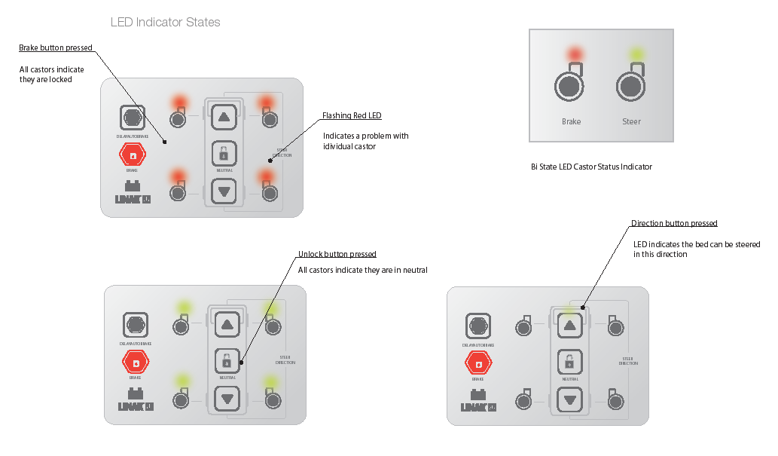
User interface – handset design
Handset Design
  Uses Linak’s existing LED and button positions and standard handsets

Slide 18
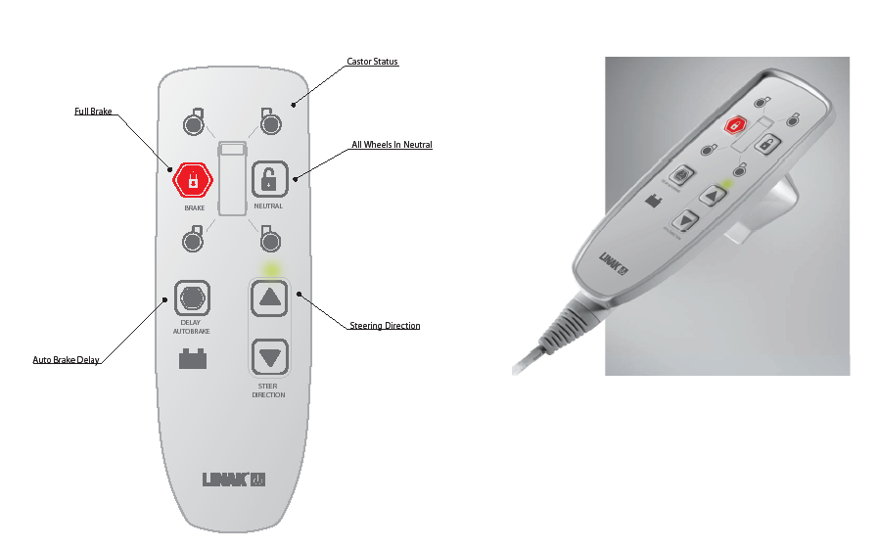
User interface – handset design
Handset Design
  Uses Linak’s existing LED and button positions and standard handsets

Slide 19
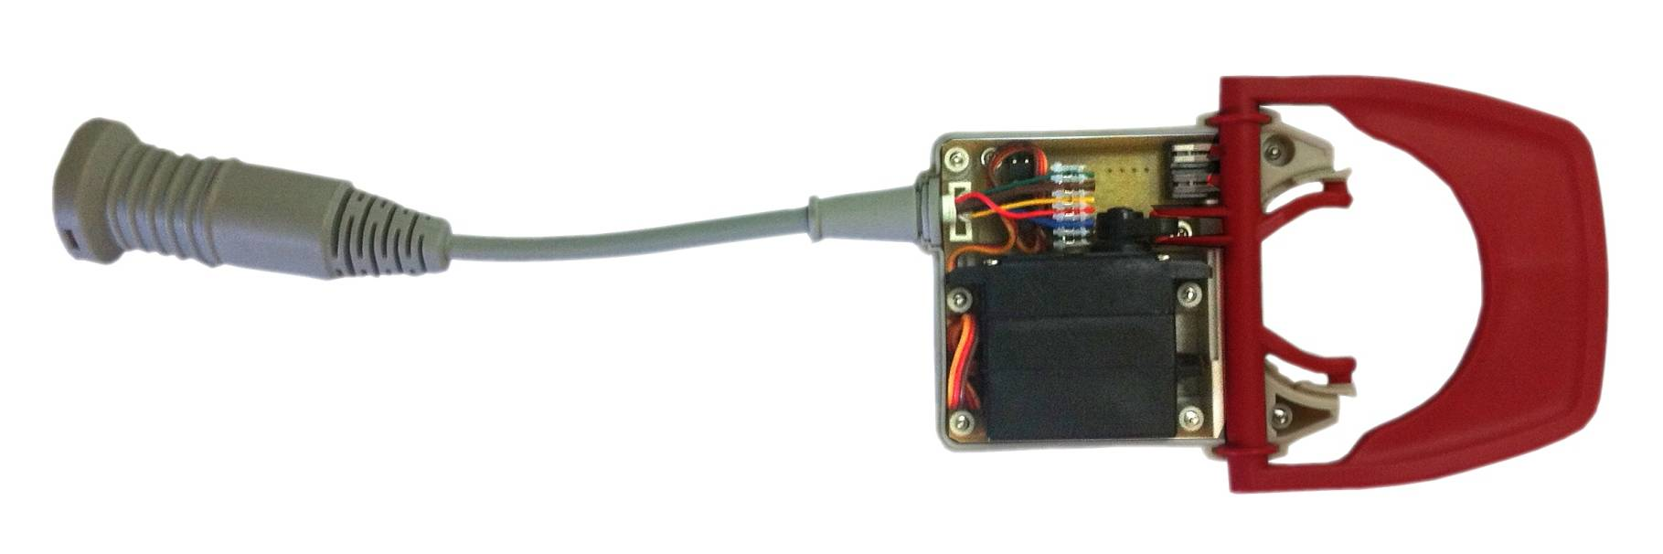
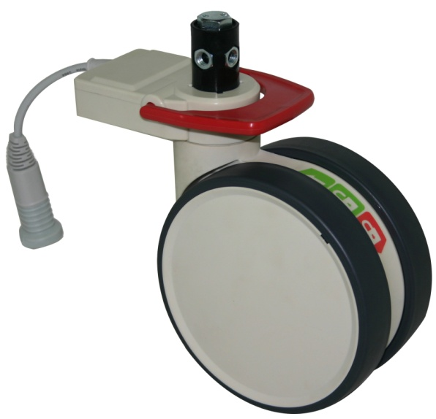
Technical Information
Fallshaw’s castor is modular (same base as regular Trinity Castors, with a different swivel head). The electronic swivel head contains:
  Servo motor (requires 8.2V to drive)
  PCB with feedback switches, motion sensor (1 per set of 4 castors) and microprocessor. The microprocessor interprets the motion data and filters the signal to provide a simple YES/NO motion signal (so that patient movement is distinguished from bed movement)
  Interface cable with 6 pins:
    Servo power (8.2V) / Pulse drive (servo) / Constant power (5V) / Brake status (voltage) / Motion (yes/no) / Ground (earth)
  Linak provides: power / handset / controller (to interpret the feedback of brake status and motion and control the system accordingly)

Slide 20
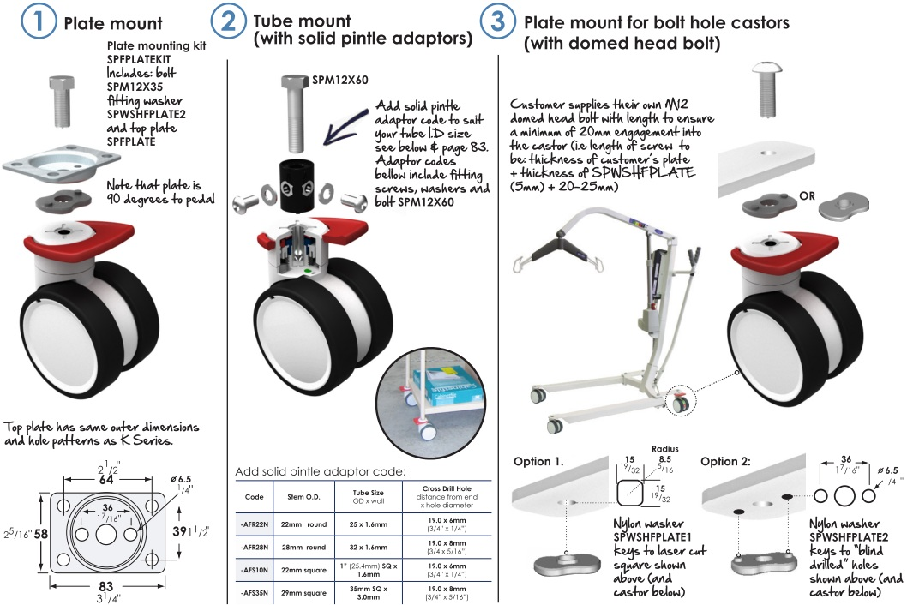
Same installation options as Fallshaw’s standard Trinity castor – design freedom!
Technical Information

Slide 21
Price
Price for castor sets (including motion sensing):
The 100mm version will be AUD $215 per set
(ex works Melbourne, ex GST)
The 150mm version will be AUD $225 per set
(ex works Melbourne, ex GST)
Controller additional, but saving on hex rod system
21

Slide 22
Development Timeline
Jan-March 2012:
  Next round of prototyping (fully in-house tested and refined castors & controllers).
  Submit IEC 60601 compliance documentation.
  Appoint after-sales service provider in UK/Europe (Hugo Technology) and the US (TBA)
March 2012:
  Hospital field trials commence (in Australia – Kooweerup hospital) and sample sets available for selected customers to trial in-house.
May 2012:
  Train after-sales service providers
  Hospital field trials expanded to include selected customers
July 2012:
  Release for mass production and sale.
22

Slide 23
Key Selling Features
Automatically applied brakes
(reduces cost of falls due to brakes being unlocked)
– goes on after 60 seconds of non-movement
Brakes can be applied using the pedals or the handset
(whatever is easier and more intuitive for the user)
In the event of a flat battery, castors can still be controlled manually (individually).
This is intuitive (everyone knows how to use pedals – no instruction manual required and no key to lose!). Note that these are the only electronic central locking castors available that have pedals.
Individual brake status feedback (can be indicated on control panel)
Bed can be easily steered from both directions (equally easy to steer from the head and foot ends of the bed)
Ultra, ultra, ultra-low central locking castors compatible with column-style floor beds (high/low beds) - reduces injuries due to falls
IPX5 water resistance
Customizable and programmable via Linak’s OpenBus platform
23

